Slide 1
Linux Basics

Slide 2
Unix
Developed at AT&T Bell Labs
Written in C (for quicker modification, acceptance, and portability)
The Unix OS works on CLI (Command Line Interface), but recently, there have been developments for GUI on Unix systems.
Unix is an OS which is popular in companies, universities big enterprises, etc.

Slide 3
UNIX Introduction
The UNIX operating system is made up of three parts;
  the kernel, the shell and the programs.
The kernel of UNIX is the hub of the operating system:
  it allocates time and memory to programs and handles the file store and communications in response to system calls.
The shell acts as an interface between the user and the kernel.

Slide 4
Unix System Structure
user
c programs
scripts
ls
ksh
Gcc
find
shell and utilities
open()
fork()
exec()
kernel
hardware

Slide 5
LINUX
The saying, "If it walks like a duck, quacks like a duck, and looks like a duck, then it must be a duck," is usually quoted to make a point about some issue during a political debate. Similarly, if Linux looks like Unix, behaves like Unix, and handles security and processes like Unix, then it must be Unix--albeit a new and improved Unix flavor, but Unix nonetheless.

Slide 6
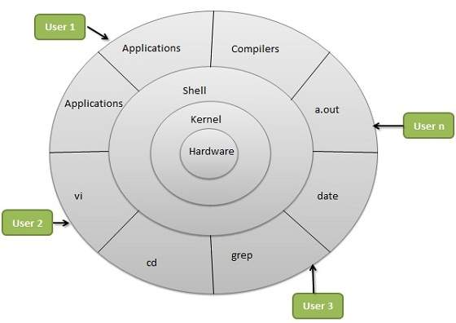
Linux system architecture

Slide 7
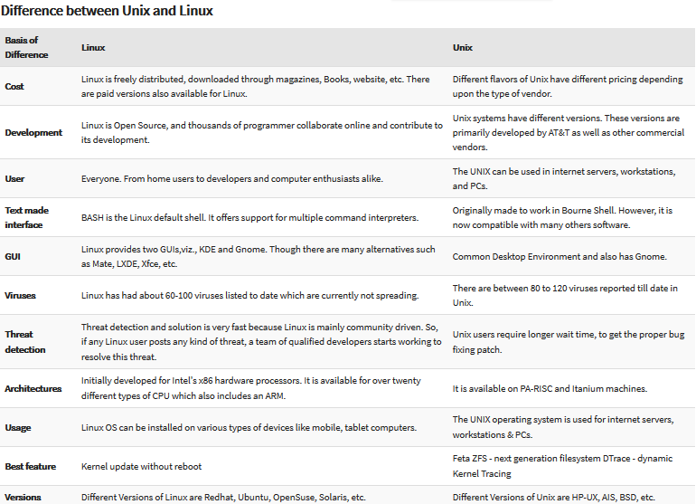
Difference between UNIX and LINUX

Slide 8

Linux Distros

Slide 9
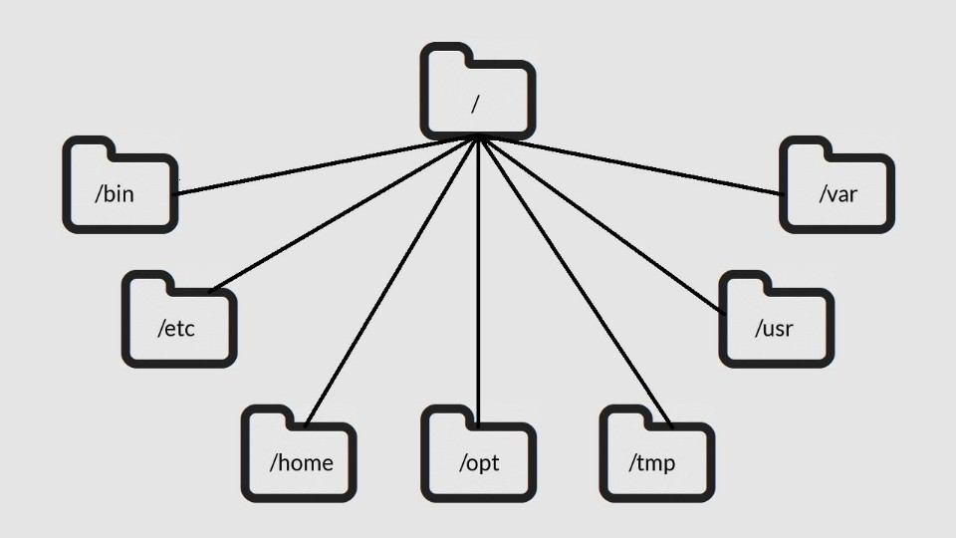
File System

Slide 10
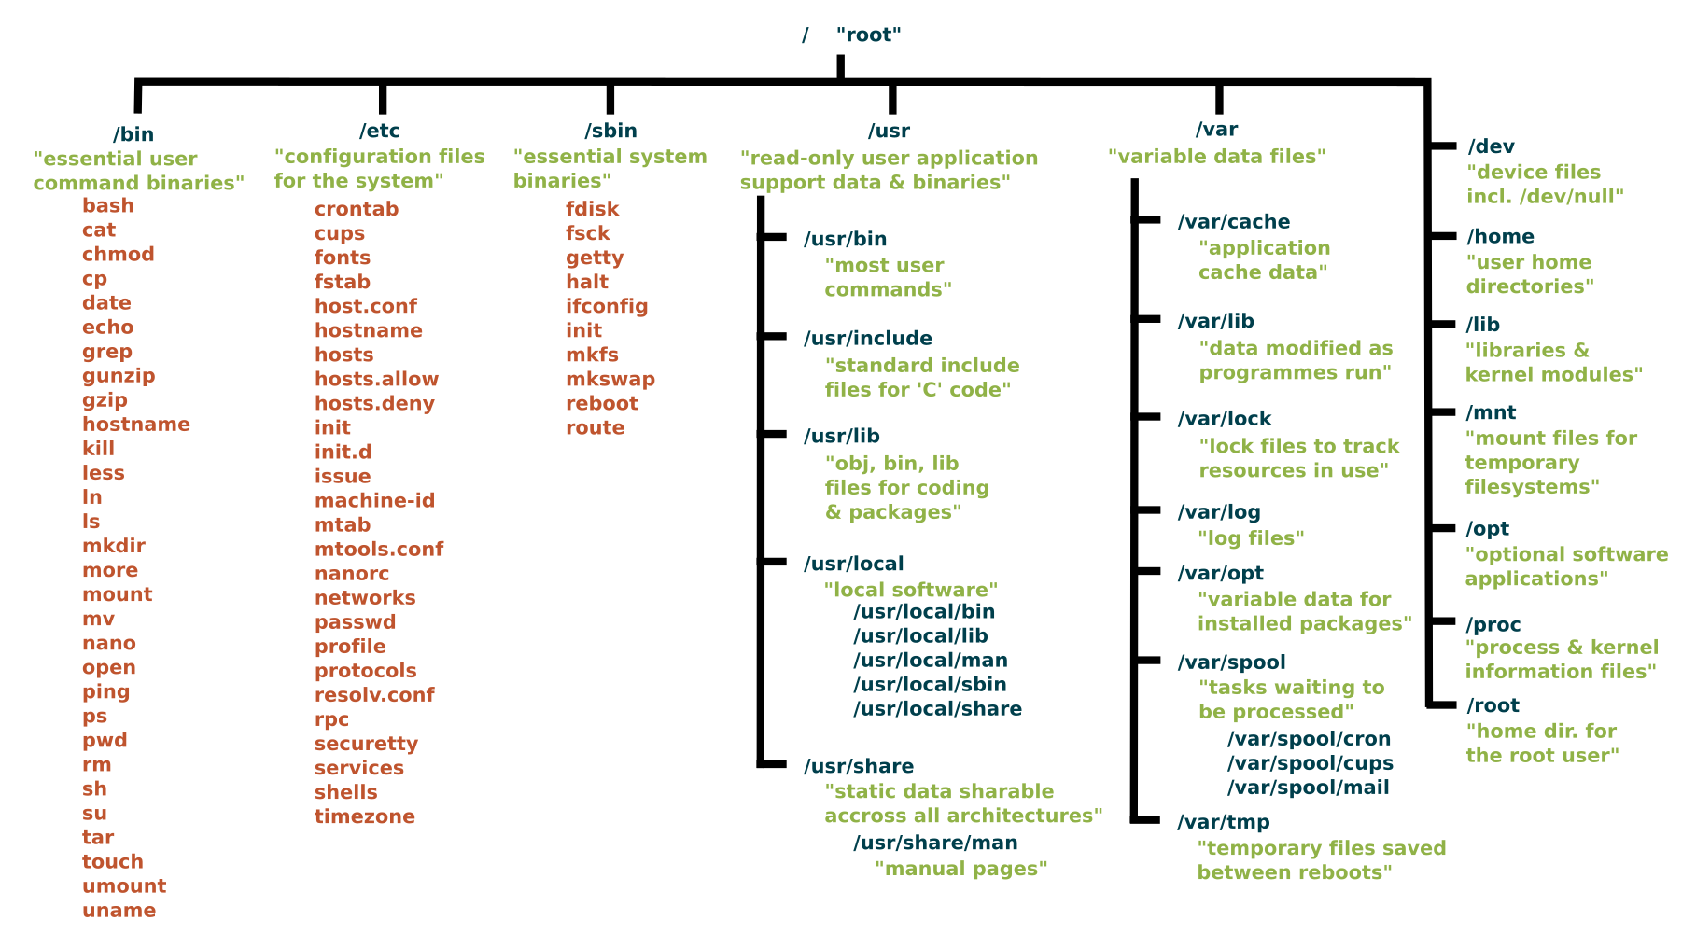
Conti..

Slide 11
Command I/O
Input to shell:
  Command name and arguments typed by the user
Input to a command:
  Keyboard, file, or other commands
Standard input: keyboard.
Standard output: screen.
These STDIN and STDOUT are often together referred to as a terminal.
Both standard input and standard output can be redirected from/to a file or other command.
File redirection:
  < input
  > output
  >> output append

Slide 12
Commands

Slide 13
man
Manual Pages
The first command to remember
Contains info about almost everything :-)
  other commands
  system calls
  c/library functions
  other utils, applications, configuration files
To read about man itself type:
% man man
NOTE: unfortunately there’s no
% man woman ...

Slide 14
which
Displays a path name of a command.
Searches a path environmental variable for the command and displays the absolute path.
To find which tcsh and bash are actually in use, type:
% which tcsh
% which bash
Which ls
% man which for more details

Slide 15
whereis
Display all locations of a command (or some other binary, man page, or a source file).
Searchers all directories to find commands that match whereis’ argument
% whereis tcsh

Slide 16
General Commands

Slide 17
passwd
Change your login password.
A very good idea after you got a new one.
It’s usually a paranoid program asking your password to have at least 6 chars in the password, at least two alphabetical and one numerical characters. Some other restrictions (e.g. dictionary words or previous password similarity) may apply.
Depending on a privilege, one can change user’s and group passwords as well as real name, login shell, etc.
% man passwd

Slide 18
date
Guess what :-)
Displays dates in various formats
% date
% date -u
  in GMT
% man date
July 10, 2003
Serguei A. Mokhov, mokhov@cs.concordia.ca

Slide 19
cal
Calendar
  for month
  entire year
Years range: 1 - 9999
No year 0
Calendar was corrected in 1752 - removed 11 days
% cal current month
% cal 2 2000 Feb 2000, leap year
% cal 2 2100 not a leap year
% cal 2 2400 leap year
% cal 9 1752 11 days skipped
% cal 0 error
% cal 2002 whole year

Slide 20
clear
Clears the screen
There’s an alias for it: Ctrl+L
Example sequence:
  % cal
  % clear
  % cal
  Ctrl+L

Slide 21
sleep
“Sleeping” is doing nothing for some time.
Usually used for delays in shell scripts.
% sleep 2 2 seconds pause

Slide 22
Command Grouping
Semicolon: “;”
Often grouping acts as if it were a single command, so an output of different commands can be redirected to a file:
% (date; cal; date) > out.txt

Slide 23
alias
Defined a new name for a command
% alias
  with no arguments lists currently active aliases
% alias newcommand oldcommand
  defines a newcommand
% alias cl cal 2003
% cl

Slide 24
unalias
Removes alias
Requires an argument.
% unalias cl

Slide 25
history
Display a history of recently used commands
% history
  all commands in the history
% history 10
  last 10
% history -r 10
  reverse order
% !!
  repeat last command
% !n
  repeat command n in the history
% !-1
  repeat last command = !!
% !-2
  repeat second last command
% !ca
  repeat last command that begins with ‘ca’

Slide 26
exit / logout
Exit from your login session.
% exit
% logout

Slide 27
shutdown
Causes system to shutdown or reboot cleanly.
May require superuser privileges
% shutdown -h now - stop
% shutdown -r now - reboot

Slide 28
Files

Slide 29
ls
List directory contents
Has whole bunch of options, see man ls for details.
% ls
  all files except those starting with a “.”
% ls -a
  all
% ls -A
  all without “.” and “..”
% ls -F
  append “/” to dirs and “*” to executables
% ls -l
  long format
% ls -al
% ls -lt
  sort by modification time (latest - earliest)
% ls -ltr
  reverse

Slide 30
cat
Display and concatenate files.
% cat
  Will read from STDIN and print to STDOT every line you enter.
% cat file1 [file2] ...
  Will concatenate all files in one and print them to STDOUT
% cat > filename
  Will take whatever you type from STDIN and will put it into the file filename
To exit cat or cat > filename type Ctrl+D to indicate EOF (End of File).

Slide 31
more / less
Pagers to display contents of large files page by page or scroll line by line up and down.
Have a lot of viewing options and search capability.
Interactive. To exit: ‘q’
Cat /var/log/auth.log

Slide 32
less
less ("less is more") a bit more smart than the more command
to display contents of a file:
  % less filename
To display line numbers:
  % less -N filename
To display a prompt:
  % less -P"Press 'q' to quit" filename
Combine the two:
  % less -NP"Blah-blah-blah" filename
For more information:
  % man less

Slide 33
touch
By touching a file you either create it if it did not exists (with 0 length).
Or you update it’s last modification and access times.
There are options to override the default behavior.
% touch file
% man touch

Slide 34
cp
Copies files / directories.
% cp [options] <source> <destination>
% cp file1 file2
% cp file1 [file2] … /directory
Useful option: -i to prevent overwriting existing files and prompt the user to confirm.

Slide 35
mv
Moves or renames files/directories.
% mv <source> <destination>
  The <source> gets removed
% mv file1 dir/
% mv file1 file2
  rename
% mv file1 file2 dir/
% mv dir1 dir2

Slide 36
rm
Removes file(s) and/or directories.
% rm file1 [file2] ...
% rm -r dir1 [dir2] ...
% rm -r file1 dir1 dir2 file4 ...

Slide 37
script
Writes a log (a typescript) of whatever happened in the terminal to a file.
% script [file]
% script
  all log is saved into a file named typescript
% script file
  all log is saved into a file named file
To exit logging, type:
  % exit

Slide 38
mkdir
Creates a directory.
% mkdir newdir
Often people make an alias of md for it.

Slide 39
cd
Changes your current directory to a new one.
% cd /some/other/dir
  Absolute path
% cd subdir
  Assuming subdir is in the current directory.
% cd
  Returns you to your home directory.

Slide 40
pwd
Displays personal working directory, i.e. your current directory.
% pwd

Slide 41
rmdir
Removes a directory.
% rmdir dirname
Equivalent:
  % rm -r dirname

Slide 42
ln
Symbolic link or a “shortcut” in M$ terminology.
% ln –s <real-name> <fake-name>

Slide 43
chmod
Changes file permissions
Possible invocations
  % chmod 600 filename
  -rw------- 1 user group 2785 Feb 8 14:18 filename
  (a bit not intuitive where 600 comes from)
  % chmod u+rw filename
  (the same thing, more readable)
  For the assignment:
    % chmod u+x myshellscript
    (mysshellscript is now executable)
    -rwx------ 1 user group 2785 Feb 8 14:18 myshellscript

Slide 44
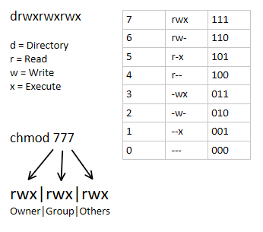

Slide 45
Reference Class Description
u owner file's owner
g group users who are members of the file's group
o others users who are neither the file's owner nor members of the file's group
a all All three of the above, same as ugo

Slide 46
Operator Description
+ Adds the specified modes to the specified classes
- Removes the specified modes from
the specified classes
= The modes specified are to be made the exact modes for the specified classes

Slide 47
r Permission to read the file.
w Permission to write (or delete) the file.
x Permission to execute the file, or, in the case of a directory, search it.

Slide 48
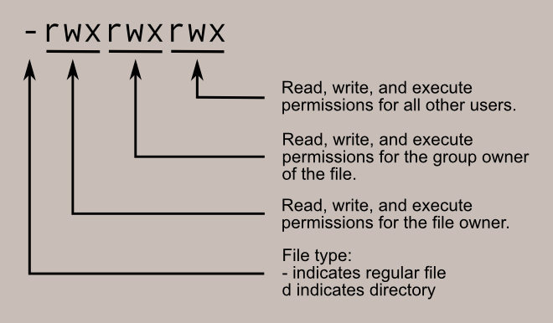
chmod 600 some_file

Slide 49
Basic Commands(1)
ls list files and directories
ls -a list all files and directories
mkdir make a directory
cd directory change to named directory
cd change to home-directory
cd ~ change to home-directory
cd .. change to parent directory
pwd display current dir path

Slide 50
Basic Commands(2)
cp file1 file2 copy file1 and call it file2
mv file1 file2 move or rename file1 to file2
rm file remove a file
rmdir directory remove a directory
cat file display a file
more file display a file a page at a time
who list users currently logged in
lpr -Pprinter psfile print postscript file to named printer
* match any number of characters
? match one character
man command read the online manual page for a command

Slide 51
Basic Commands(3)
command > file redirect standard output to a file
command >> file append standard output to a file
command < file redirect standard input from a file
grep 'keyword' file search a file for keywords
    % grep science science.txt
wc file count number of lines/words/characters in file
    % wc -w science.txt
sort sort data (numerically or alphabetically)
    Ex:
    to sort the list of object, type
    % sort < biglist
    and the sorted list will be output to the screen.

Slide 52
Thank you

Slide 53
Source ~/.bashrc
google() {
search=""
echo "Googling: $@"
for term in $@; do
search="$search%20$term"
done
xdg-open "http://www.google.com/search?q=$search"
}

